Slide 1
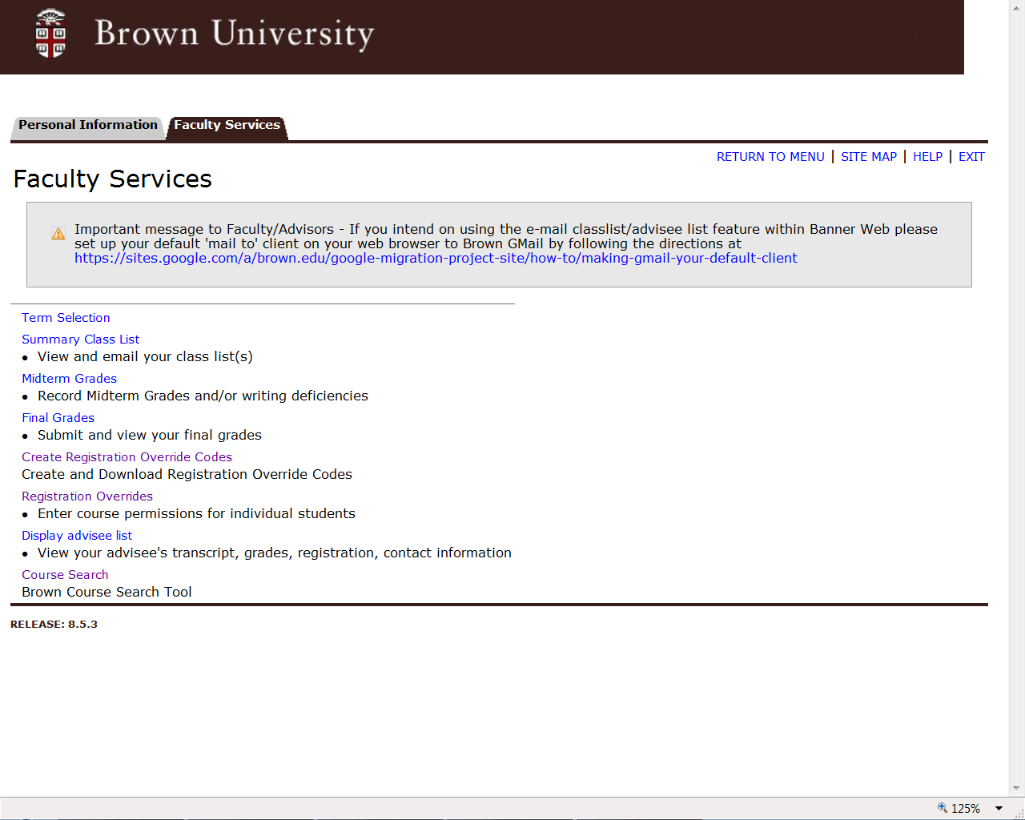
Notes:
The Create Registration Override Codes link should be in the center of the Faculty Services menu in the Secure Area of Banner Web.

Slide 2
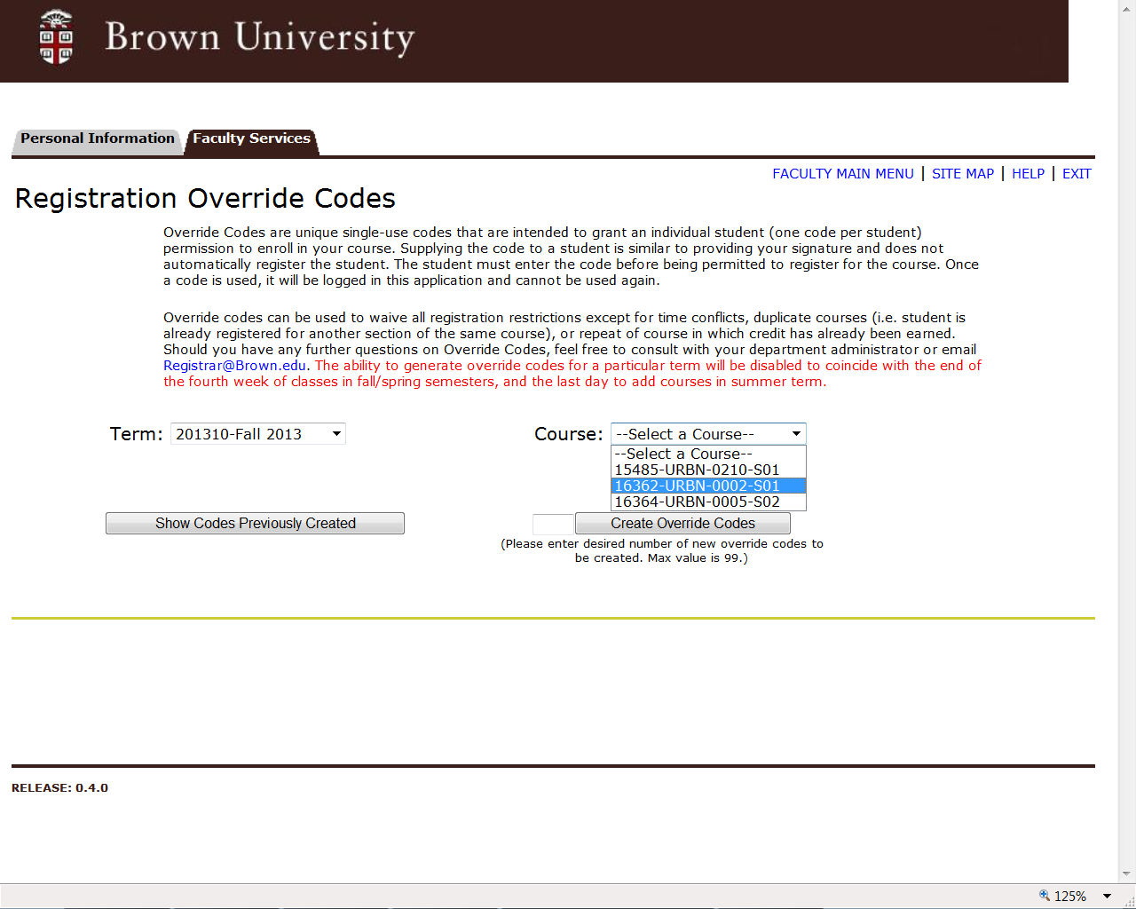
Notes:
Select a term from the drop down list. The course list will populate with your assigned course offerings – including offerings where you are a co-instructor. Select the course for which you would like to create override codes.

Slide 3
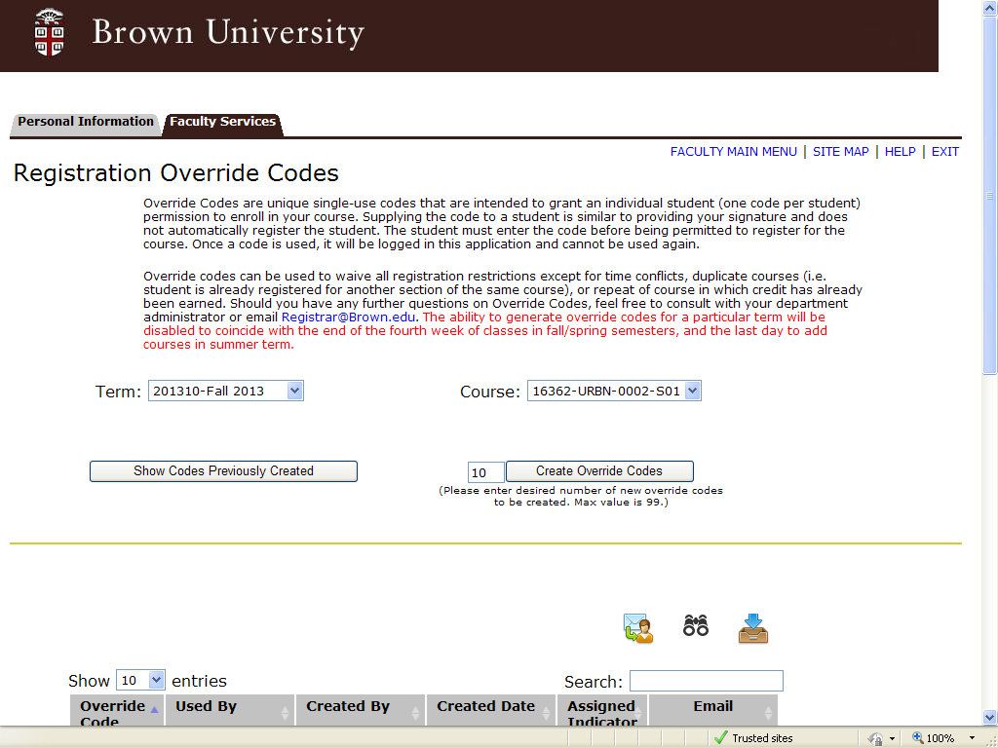
Notes:
Enter the number of override codes you would like to create and click the Create Override Codes button.

Slide 4
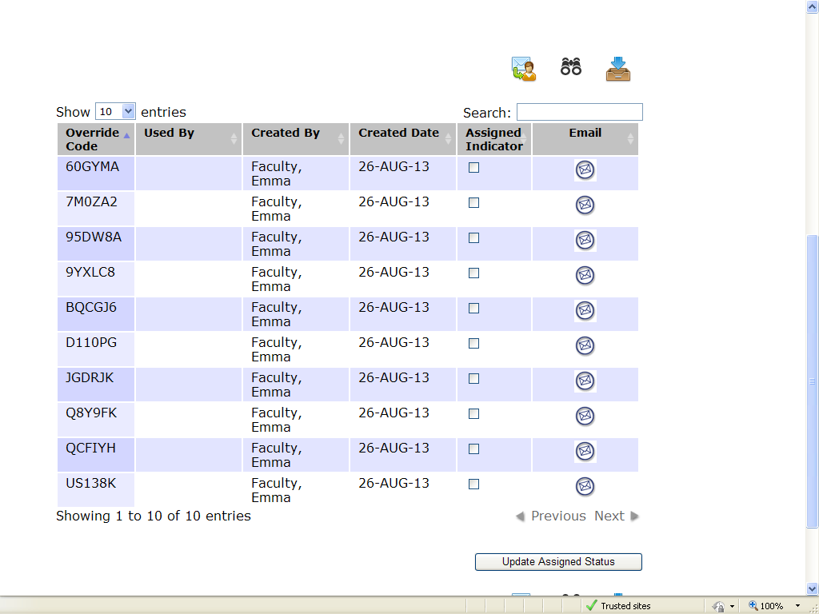
Notes:
The override codes will display with an option to Email to student. Click the Email envelope to open a Search window where you can enter the student’s Banner ID or use a name search function to find the student’s Email address.

Slide 5
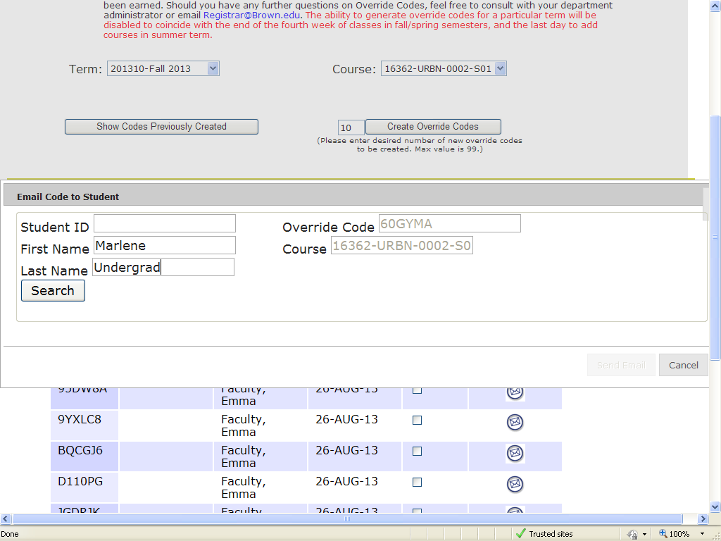
Notes:
Enter the student’s first and last name, then click the Search button to execute the search.

Slide 6
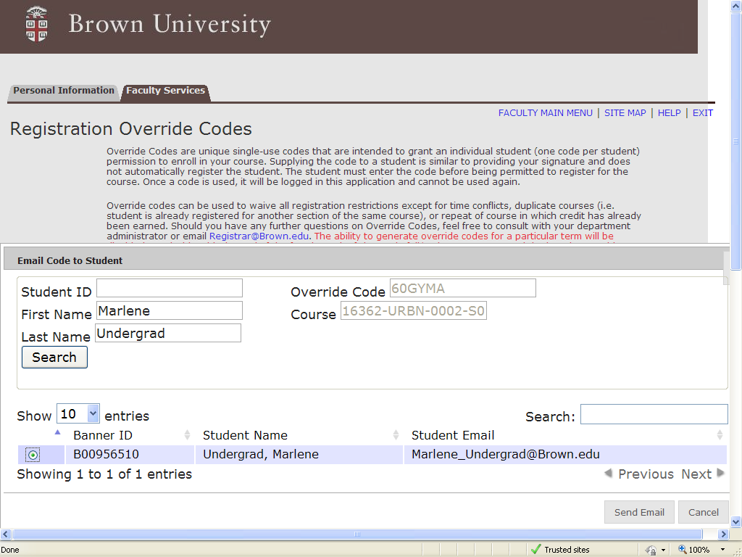
1
2
Notes:
Select the radio button next in the student row that matches your search criteria. Click the Send Email button to send the override code directly to the student.

Slide 7
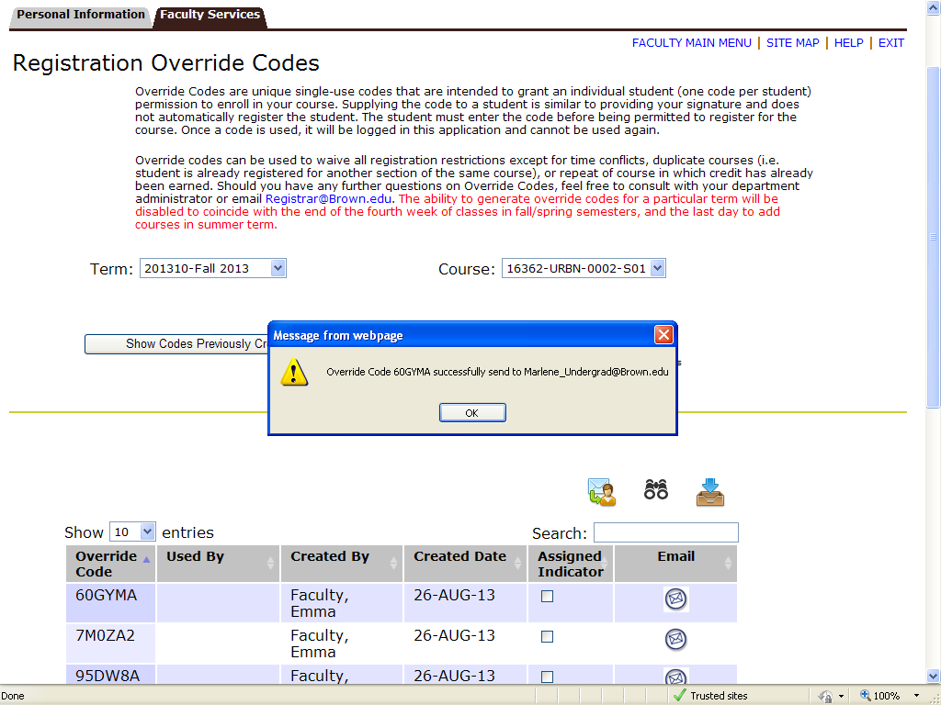
Notes:
You will receive a confirmation that the override code was sent successfully to the student.

Slide 8
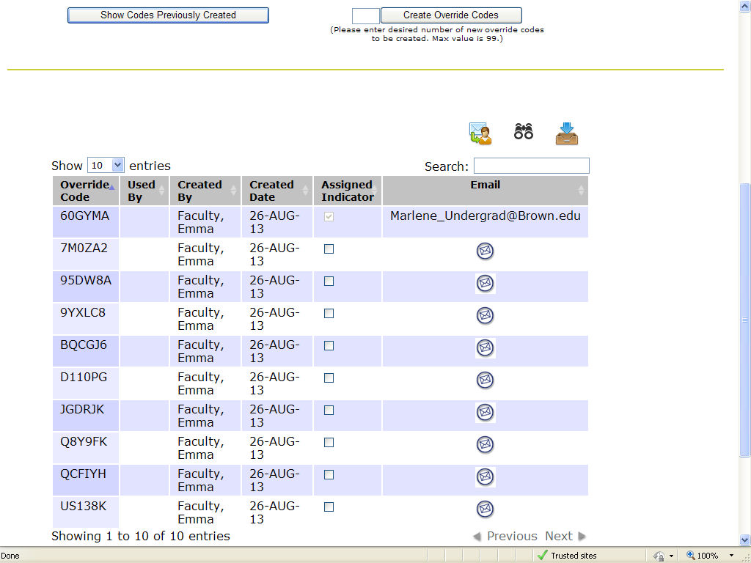
Notes:
The email address of the student will display and the assigned indicator will be set once the override code is sent to the student. You may also update the Assigned Indicator manually if you give the code to a student verbally or via a separate email. This will prevent distributing the same code to two different students. Simply click the Assigned Indicator check box and click the Update Assigned Status button.

Slide 9
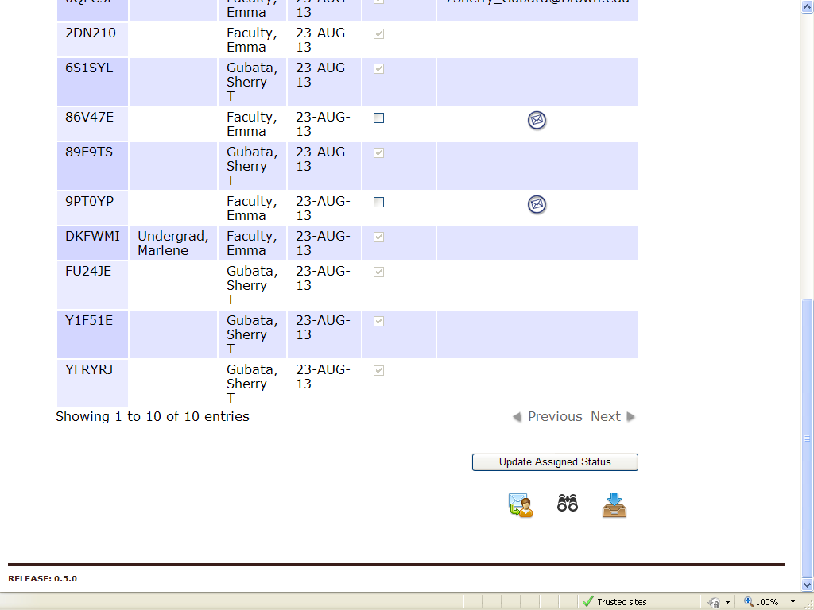
Notes:
When a student uses a registration code, the student’s name will appear in the Used By column so you may track distribution and usage.

Slide 10
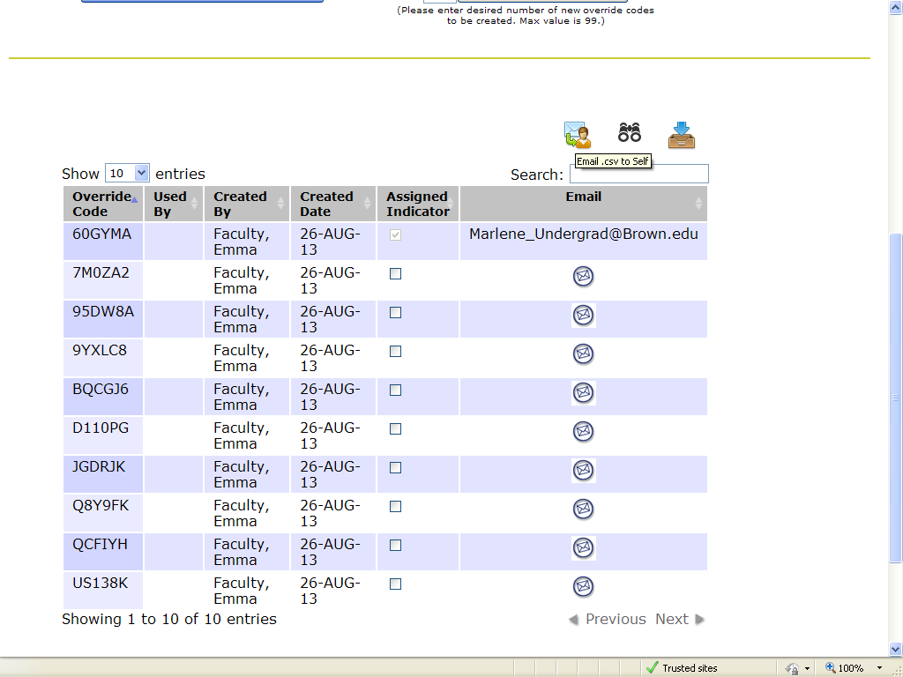
Notes:
You may use the icons to email a .csv file to yourself for distribution. Click the various icons to activate your choices for download and distribution.

Slide 11
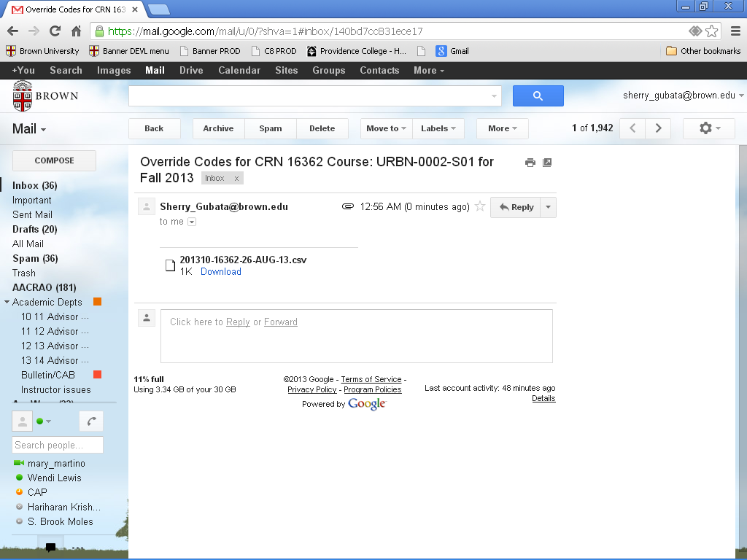
Notes:
Csv file will be delivered to your Brown Email account.

Slide 12
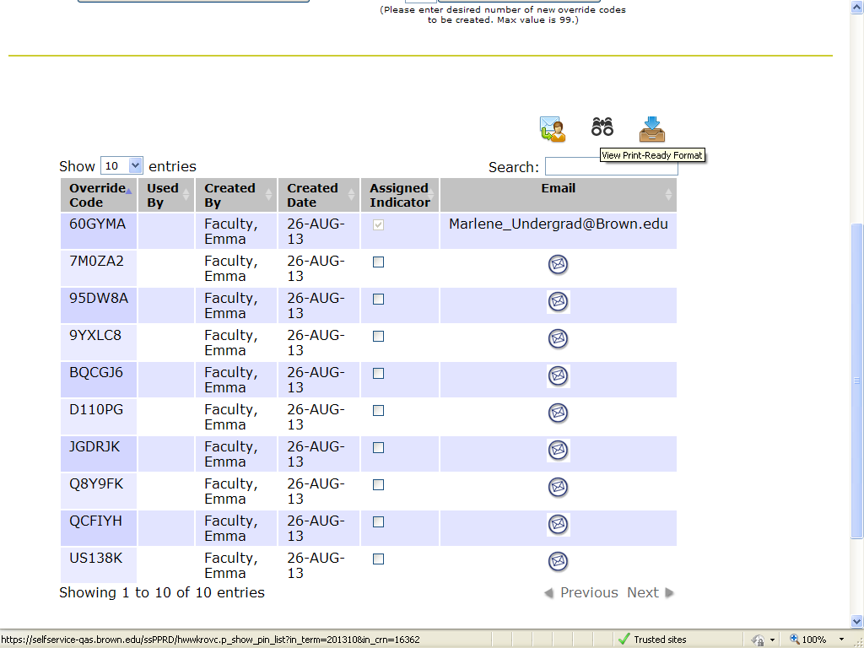
Notes:
You may use the binoculars to view a print-ready sheet of override codes that can be handed out to students during class.

Slide 13
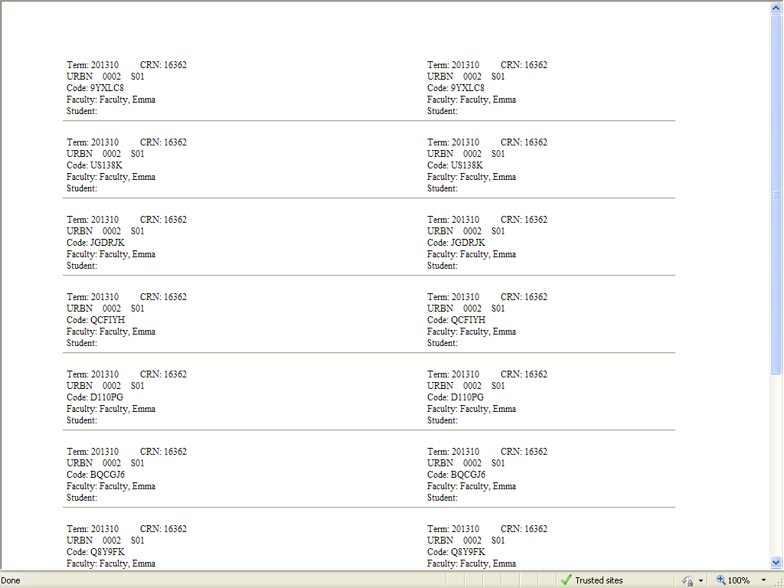
Notes:
Print-ready override codes can be printed, distributed, then used as a recording device for distribution of the override codes.

Slide 14
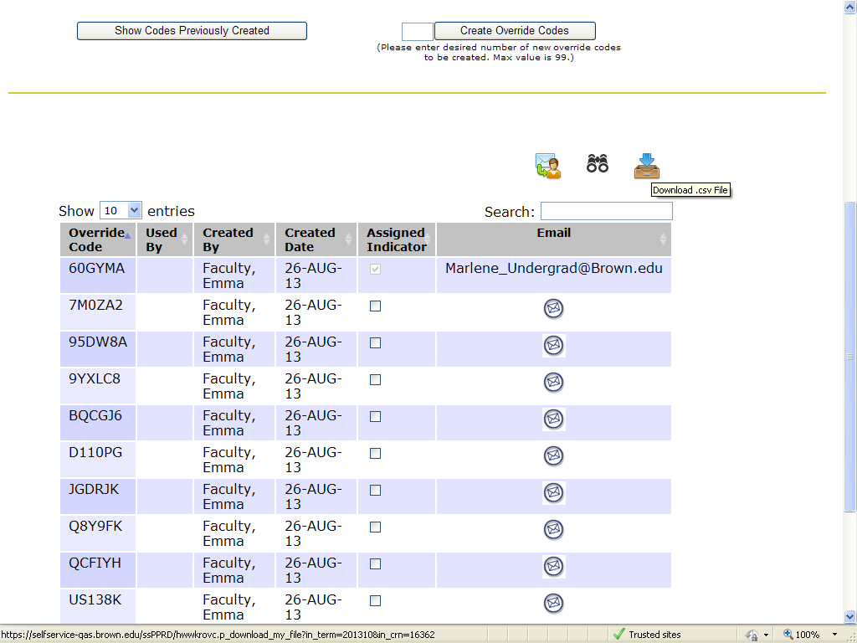
Notes:
Select this icon to download your own .csv file directly from Banner Web.

Slide 15
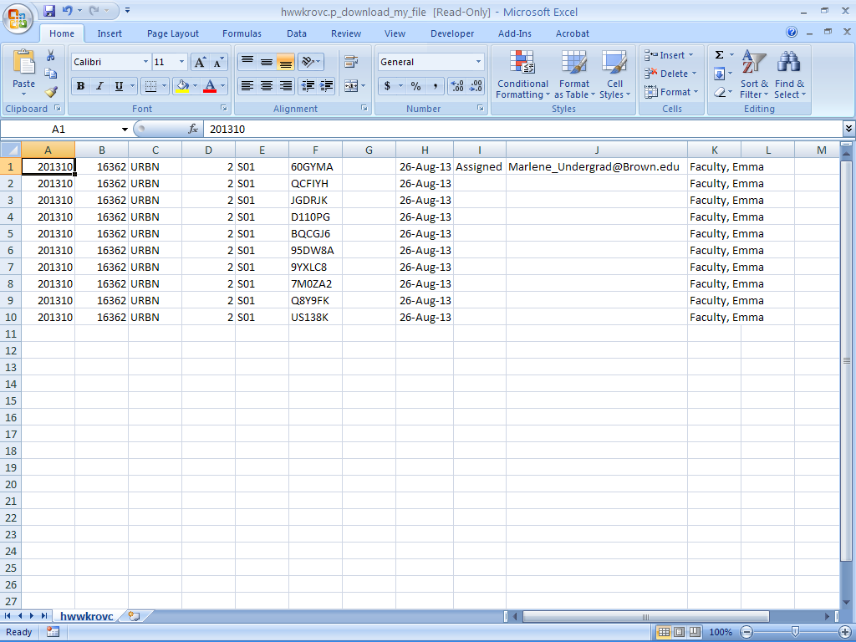
Notes:
You may have to adjust some of the column widths for your browser and display.

Slide 16
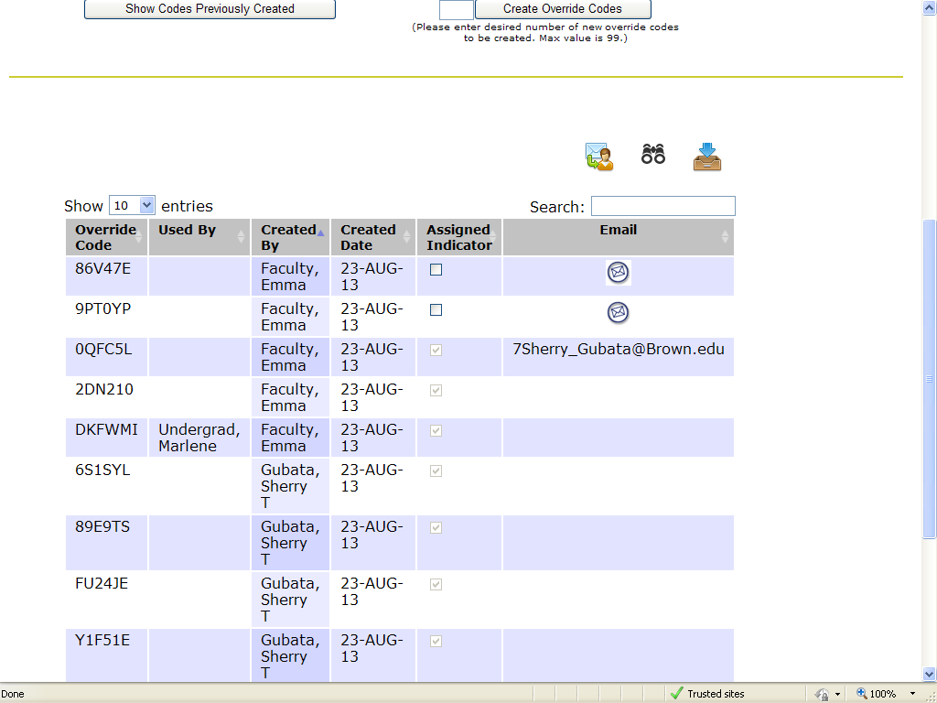
Josiah_Carberry@Brown.edu
Notes:
You can use the column header filters to display the override codes in a way that suits your purpose. Sorting by assigned Indicator will group all those that have not been assigned in one place. Filtering by ‘Used By’ will force those codes that have been assigned to the bottom of the list. Please note that override codes may be created by another instructor assigned to the course. To avoid confusion and possible duplication, you should assign only the codes that are listed with your name in the Created By column.

